Slide 1
Topic: Ratios
EQ: What is a Ratio and how is it used?
Year 7 Mathematics
Mrs Parlevliet

Slide 2
Contents
Glossary or Formula Page
Page
Date
Description
24
7
30
Word or Formula
Definition or Example

Slide 3
Tasks
24
7
30
Essential Question
Questions
Notes
Summary
1
2

Slide 4
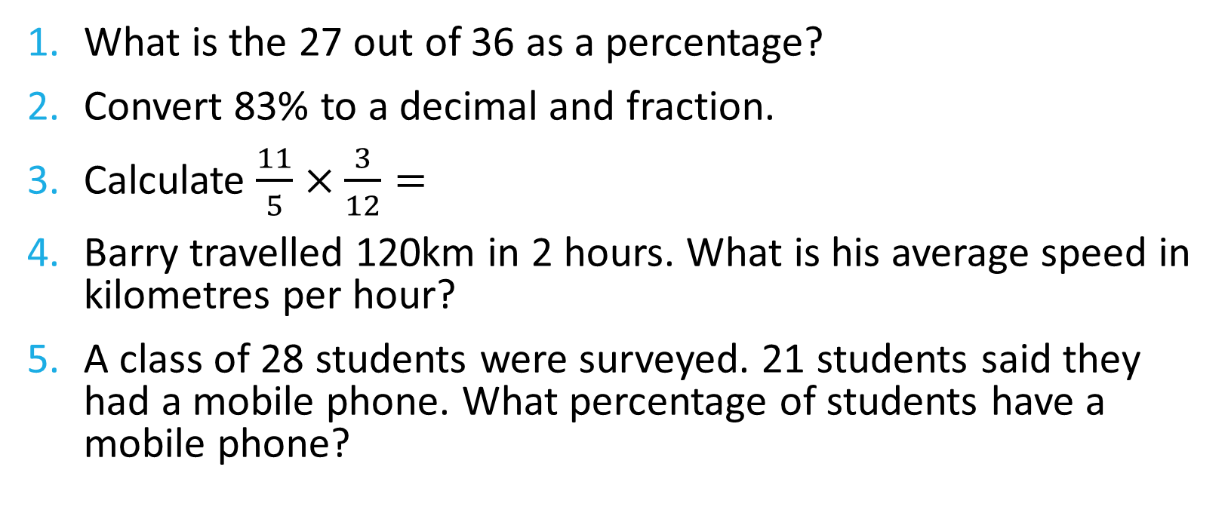
Five Questions (LHS)
What is the 27 out of 36 as a percentage?
Convert 83% to a decimal and fraction.
Calculate $\frac{11}{5}×\frac{3}{12}=$
Barry travelled 120km in 2 hours. What is his average speed in kilometres per hour?
A class of 28 students were surveyed. 21 students said they had a mobile phone. What percentage of students have a mobile phone?
Notes:
75%

Slide 5
24
7
30
Ratios
Date: XX/05/2021
EQ – What is a ratio and how is it used?
What is a ratio?
Ratios are used to compare quantities with the same units.
The ratio of 2 to 5 is written as 2 : 5
What are some examples of ratios?
Ratio of boys to girls in this Year 7 class
Ratio of the number of staff members to the number of students in a class
Ratio of hours you are asleep to hours you are awake
Notes:
Whole Body Movement – Instruct students to move into groups in the class.
Invite suggestions for other categories to consider as ratios.

Slide 6
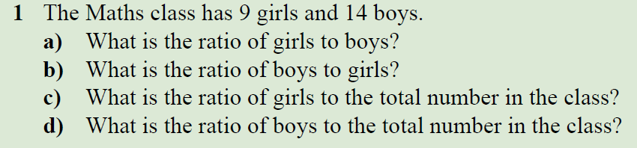
24
7
30
Ratios
Date: XX/05/2021
EQ – What is a ratio and how is it used?
How is a ratio used?
Notes:
Worked Example on Ratios.
Emphasise that order of categories being compared is important.

Slide 7
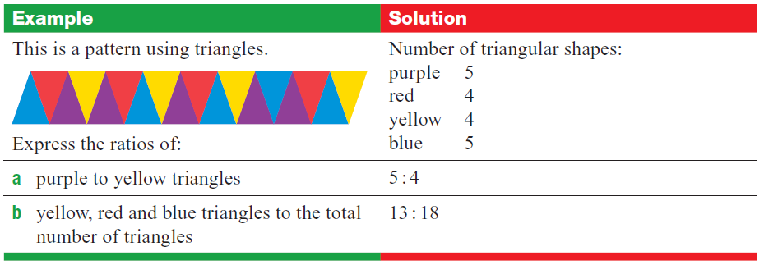

I Do

Slide 8
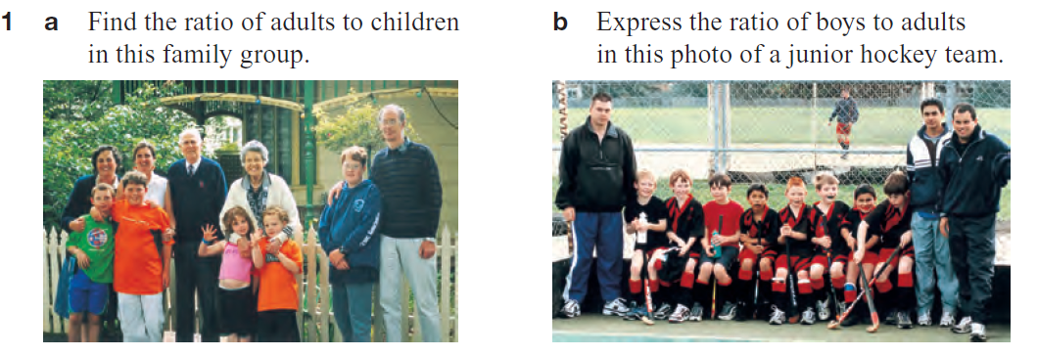
WE Do
Notes:
a) 5:5
b) 8:3

Slide 9

Notes:
Check for Understanding

Slide 10
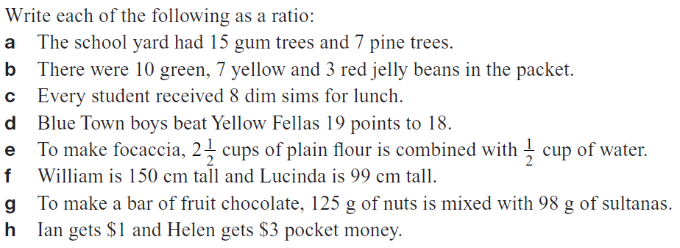
You Do(LHS)
Notes:
a) 5:5
b) 8:3

Slide 11
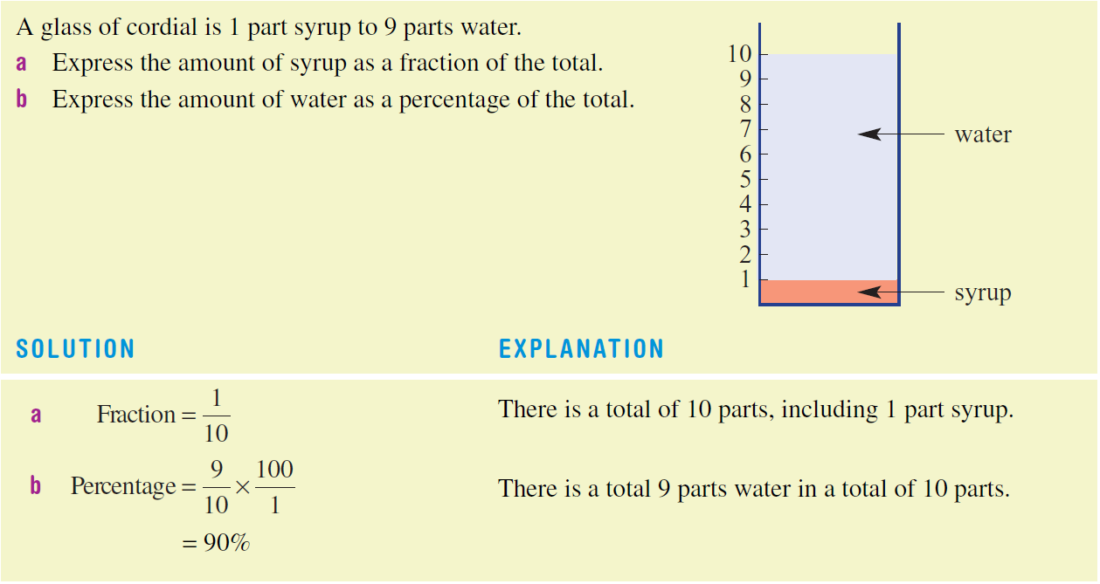
24
7
30
Ratios
Date: XX/05/2021
EQ – What is a ratio and how is it used?
How are ratios linked to fractions and percentages?

Slide 12
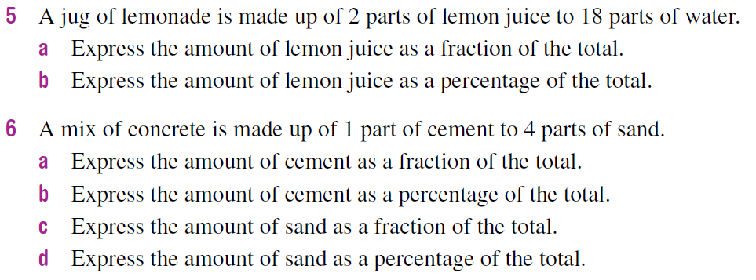
TASK (LHS)

Slide 13

Homework
Review your notes and write a summary answering the Essential Question.
Update your Contents Page

Slide 14
INB Review
24, 7 ,30
Date
Title
Essential question
Notes complete
Notes complete with colour and diagrams
Questions completed
Contents page filled in
Formula page filled in

